Slide 1
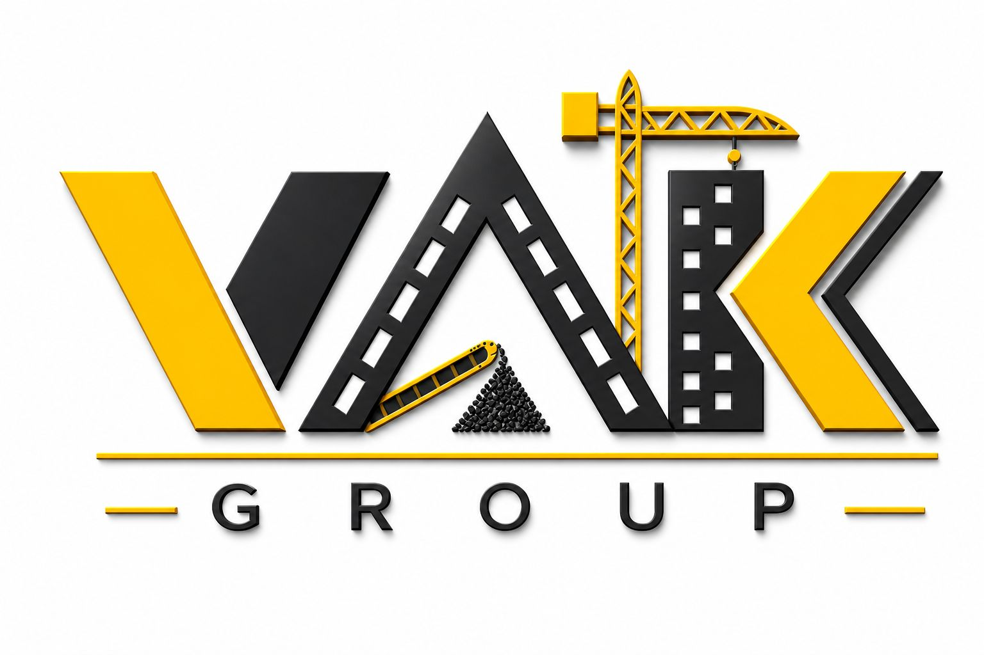
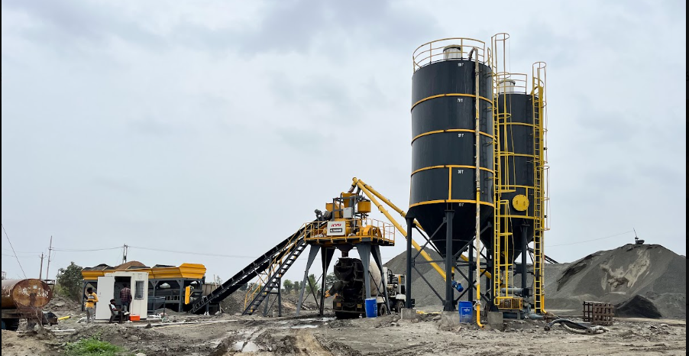
ABOUT US PRODUCT GALLERY INDUSTRIES CONTACT US CAREERS
Engineered Silos. Empowered Teams. Concrete Results.

Slide 2
Our Vision
Leadership in the cement silo industry and screen wire meshes, achieved through innovative, sustainable infrastructure solutions and anchored by a world-class, empowered workforce dedicated to absolute customer satisfaction
Our Mission
To maximize customer satisfaction as our ultimate aim by delivering high-quality products, deploying the latest manufacturing technologies, and nurturing a highly motivated, continuously trained team of professionals.
The VAK Advantage
👥 People & Culture Policy
We believe in developing, empowering, and elevating our people. Continuous technical and operational training is an essential part of our corporate DNA, ensuring our team is uniquely equipped to conquer complex heavy engineering challenges.
🔬 Quality Assurance Framework
Every product is engineered at our state-of-the-art facility, utilizing quality-approved materials and undergoing meticulous, multi-phase quality inspections approved by top-tier industrial buyers.

Slide 3
